Slide 1
저작권 개혁과 이용자 영국과 호주 사례
남희섭
2014. 12. 5.

Slide 2
영국 사례

Slide 3
In November 2010 the Prime Minister David Cameron announced an independent review of how the Intellectual Property framework supports growth and innovation.
Chaired by Professor Ian Hargreaves and assisted by a panel of experts, the review reported to Government in May 2011.
The Review makes 10 recommendations designed to ensure that the UK has an IP framework best suited to supporting innovation and promoting economic growth in the digital age.

Slide 4
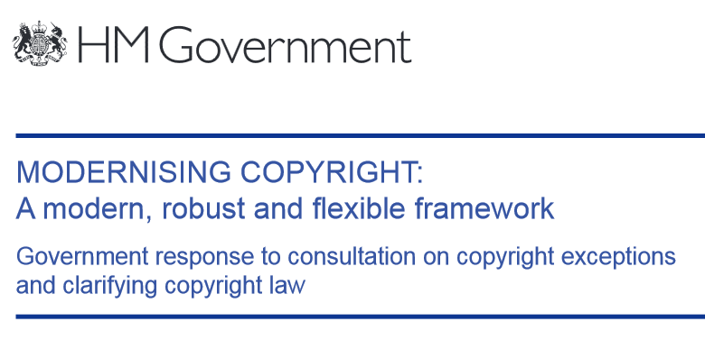
The government published a full response to its copyright consultation in December 2011 and responded in Modernising Copyright: A Modern, Robust and Flexible Framework in December 2012, outlining its broad plans for policy reform.

Slide 5
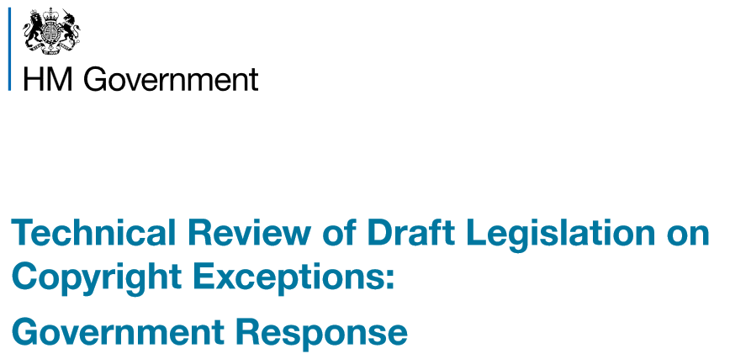
The government took the additional step of completing a technical review of draft Exceptions to Copyright regulations between June and September 2013. The full response to this technical review was published on 27 March 2014.

Slide 6
1 June 2014
the Copyright and Rights in Performances (Disability) Regulations 2014
the Copyright and Rights in Performances (Research, Education, Libraries and Archives) Regulations 2014
the Copyright (Public Administration) Regulations 2014

Slide 7
적법하게 보유한 저작물의 모든 사적 복제 허용
전자책, 디지털 음악, 비디오 파일을 포맷 변환 또는 백업 목적으로 복제할 수 있음(컴퓨터 프로그램은 제외).
구매한 CD에 있는 음악을 MP3 플레이어에 변환 저장하는 행위 ➔ 적법(구법: 위법)
클라우드에 저장 ➔ 적법. 단, 타인의 접근 허용하면 안됨.
“적법하게 보유한 저작물” ➔ 방송되는 저작물, 스트리밍 음악은 안됨.
복제 방지 기술적 조치를 금지 또는 해제할 의무를 부과하지는 않음.
친구나 가족을 위한 복제 ➔ 안됨 (구법에서도 안되었음)
사적 복제 후 원본 저작물을 판매하면 ➔ 사적 복제는 위법. 복제물 폐기하면 허용.

Slide 8
Discussion

